Slide 1
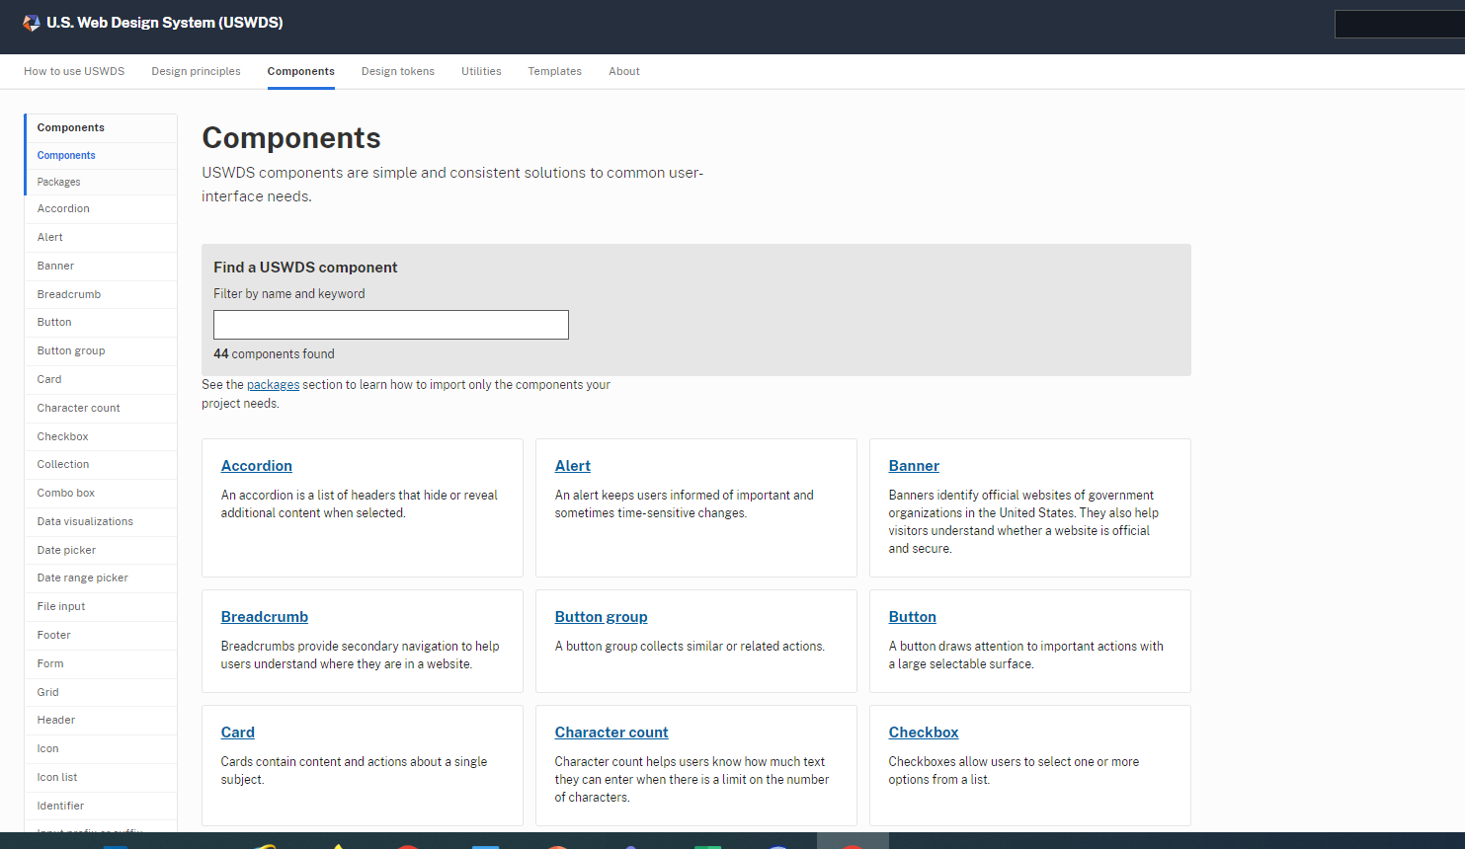
USDWS Lists Guidance By Component.

Slide 2
You Can Code Help Desk Tickets to Identify Priorities.
Type of Question | Count
Contact Us I have a different question | 235
Contact Us I need access to the SAMHSA survey data | 39
Contact Us I need access to the SAMHSA data files | 37
SAMHDA Get Help Question: Is there data available for substate areas, cities, or counties? | 13
I have a different question | 13
SAMHDA Get Help Question: What is the difference between NSDUH public- and restricted-use data? | 12
SAMHDA Get Help Question: How can data be accessed on the SAMHDA site? | 11
SAMHDA Get Help Question: How do I read data into R? | 11
SAMHDA Get Help Question: Why and how should I cite SAMHDA data? | 8
SAMHDA Get Help Question: How do I access data? | 7
SAMHDA Get Help Question: Can RDAS produce state estimates? | 7
SAMHDA Get Help Question: What are the differences between PDAS and RDAS? | 6
Many questions on how to do basic tasks:
Where are datafiles?
What are the different types of datafiles?
What do the different analysis systems do?
How do I perform a state-level analysis?

Slide 3
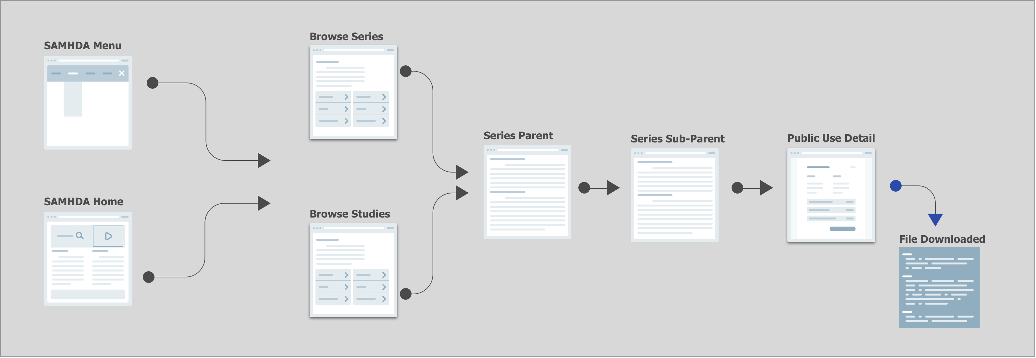
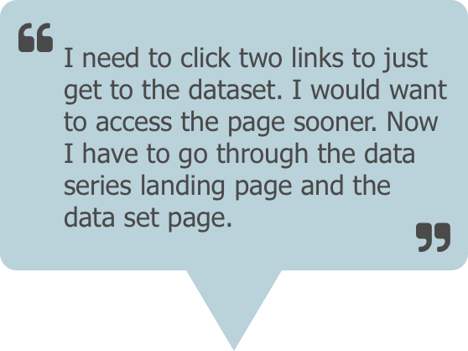
Usability Test Helped Reveal Pathway Issue.
The participants had to click 3 times to get to download a data set. For every new data set that is downloaded, this process must be repeated.
2 out of 3 participants complained about this.
Metrics used:
-Usability test
-Audit of help desk request

Slide 4
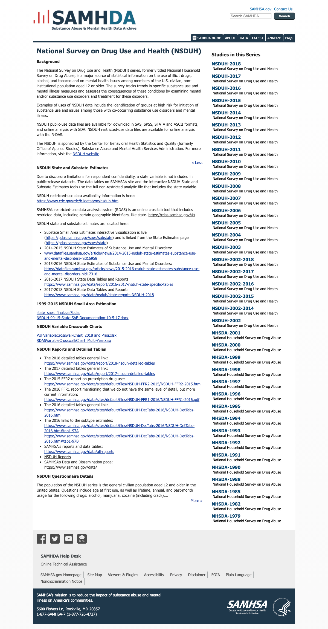
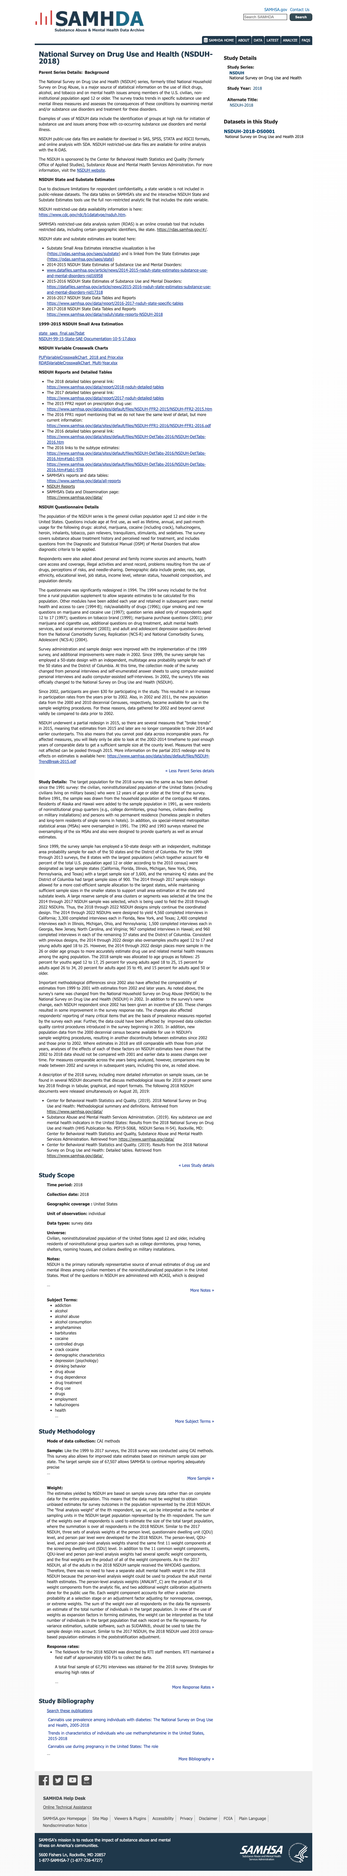
Usability Tests Show The Cognitive Lift.
A big frustration for users was the amount of content on the page.
The parent page text was repeated on all pages
The series page text was repeated on the series page and the detail page
And most of this content was already in the survey about pages on the Data Site
It was difficult to find the relevant information that was just about working with the data.

Slide 5
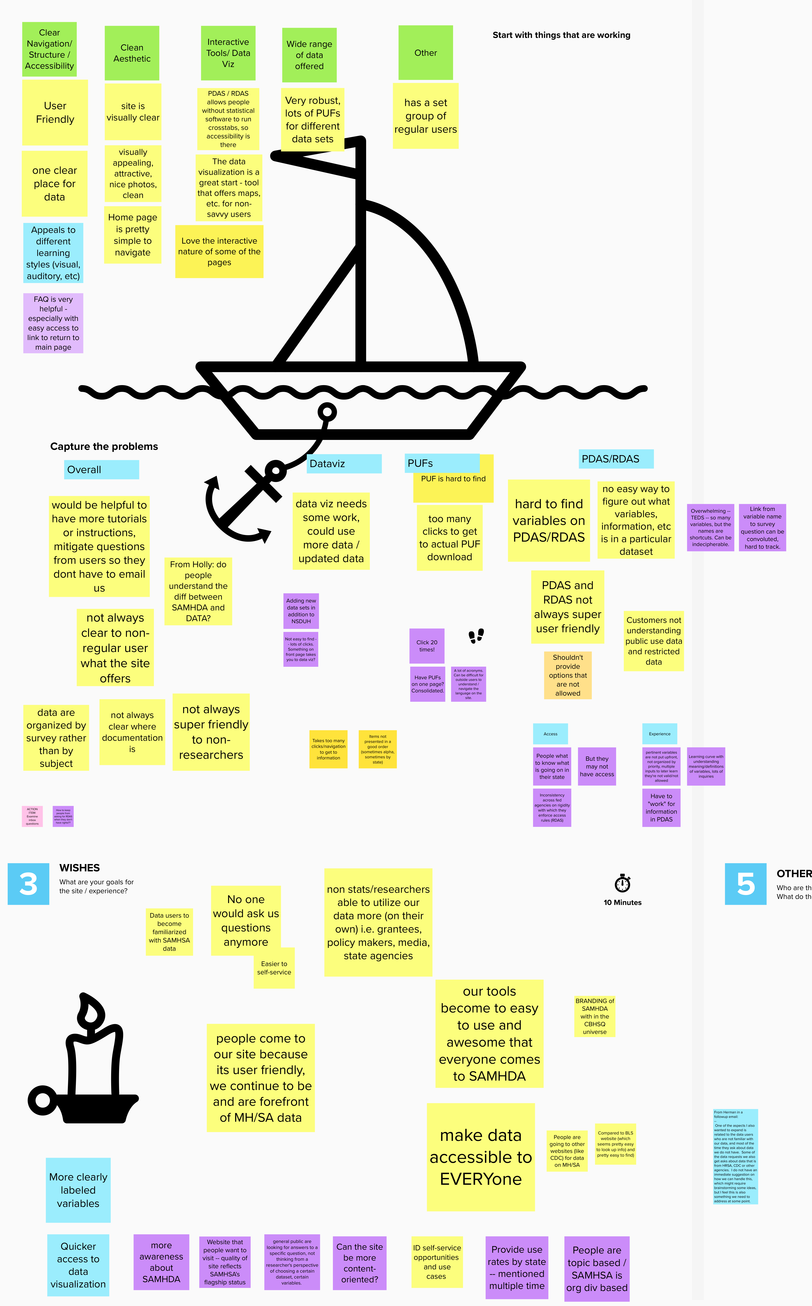
Then We Presented Ideas In Stakeholder Listening Sessions.
Listening Sessions are a way of bringing the team together (various stakeholder groups along with the COR team and working team). To discuss what was working, current problems, wishes and learnings. This helped to get everyone into a common vision for the road forward.
A part of the virtual whiteboard from the session
(Agency-owned image)

Slide 6
All Of These Inputs Helped Form A Product Strategy.
Problems to be solved
Too many pages for people to travel to get to the data file download
A lot of duplicate content within the experience
A lot of duplicate content between Data and SAMHDA
Siloed experience between Data and SAMHDA
Need to start growing the audience type

Slide 7
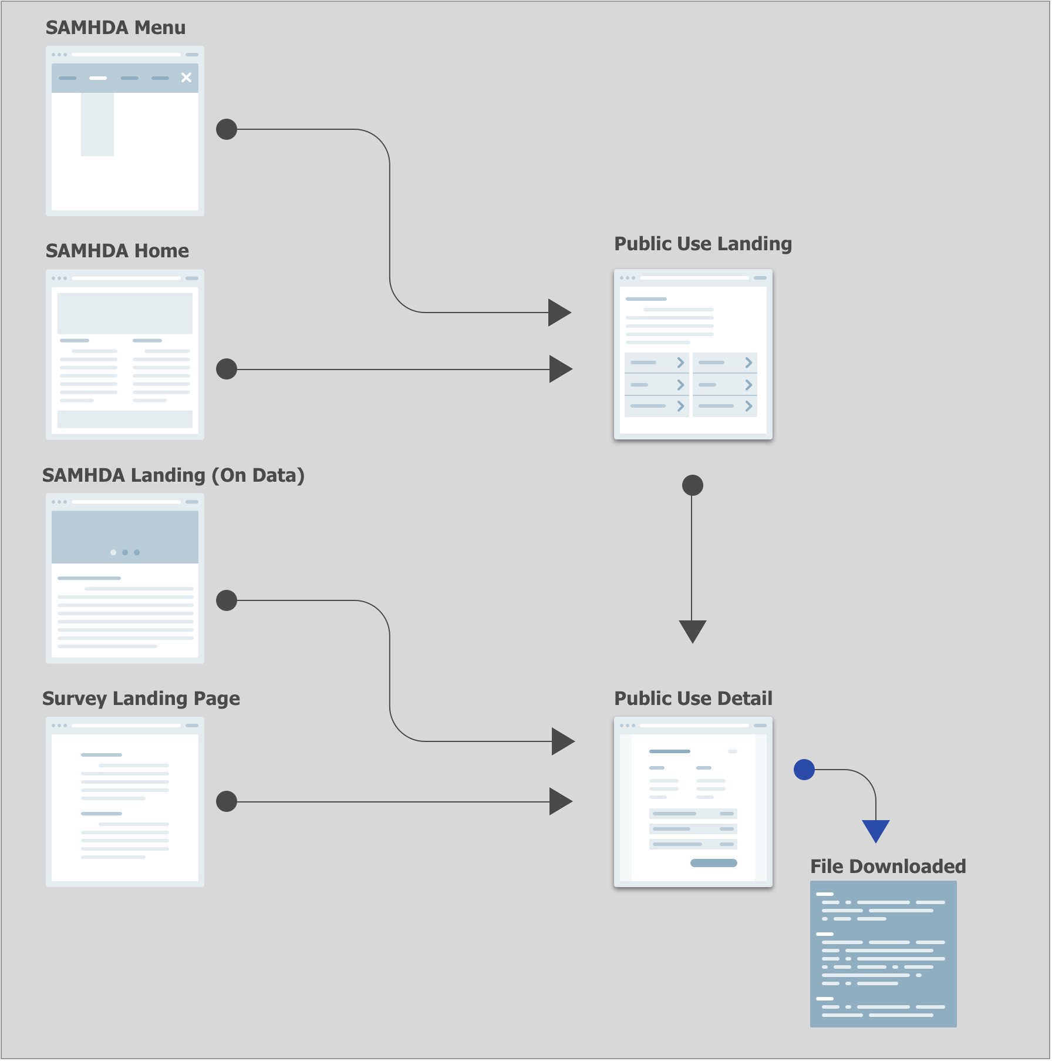
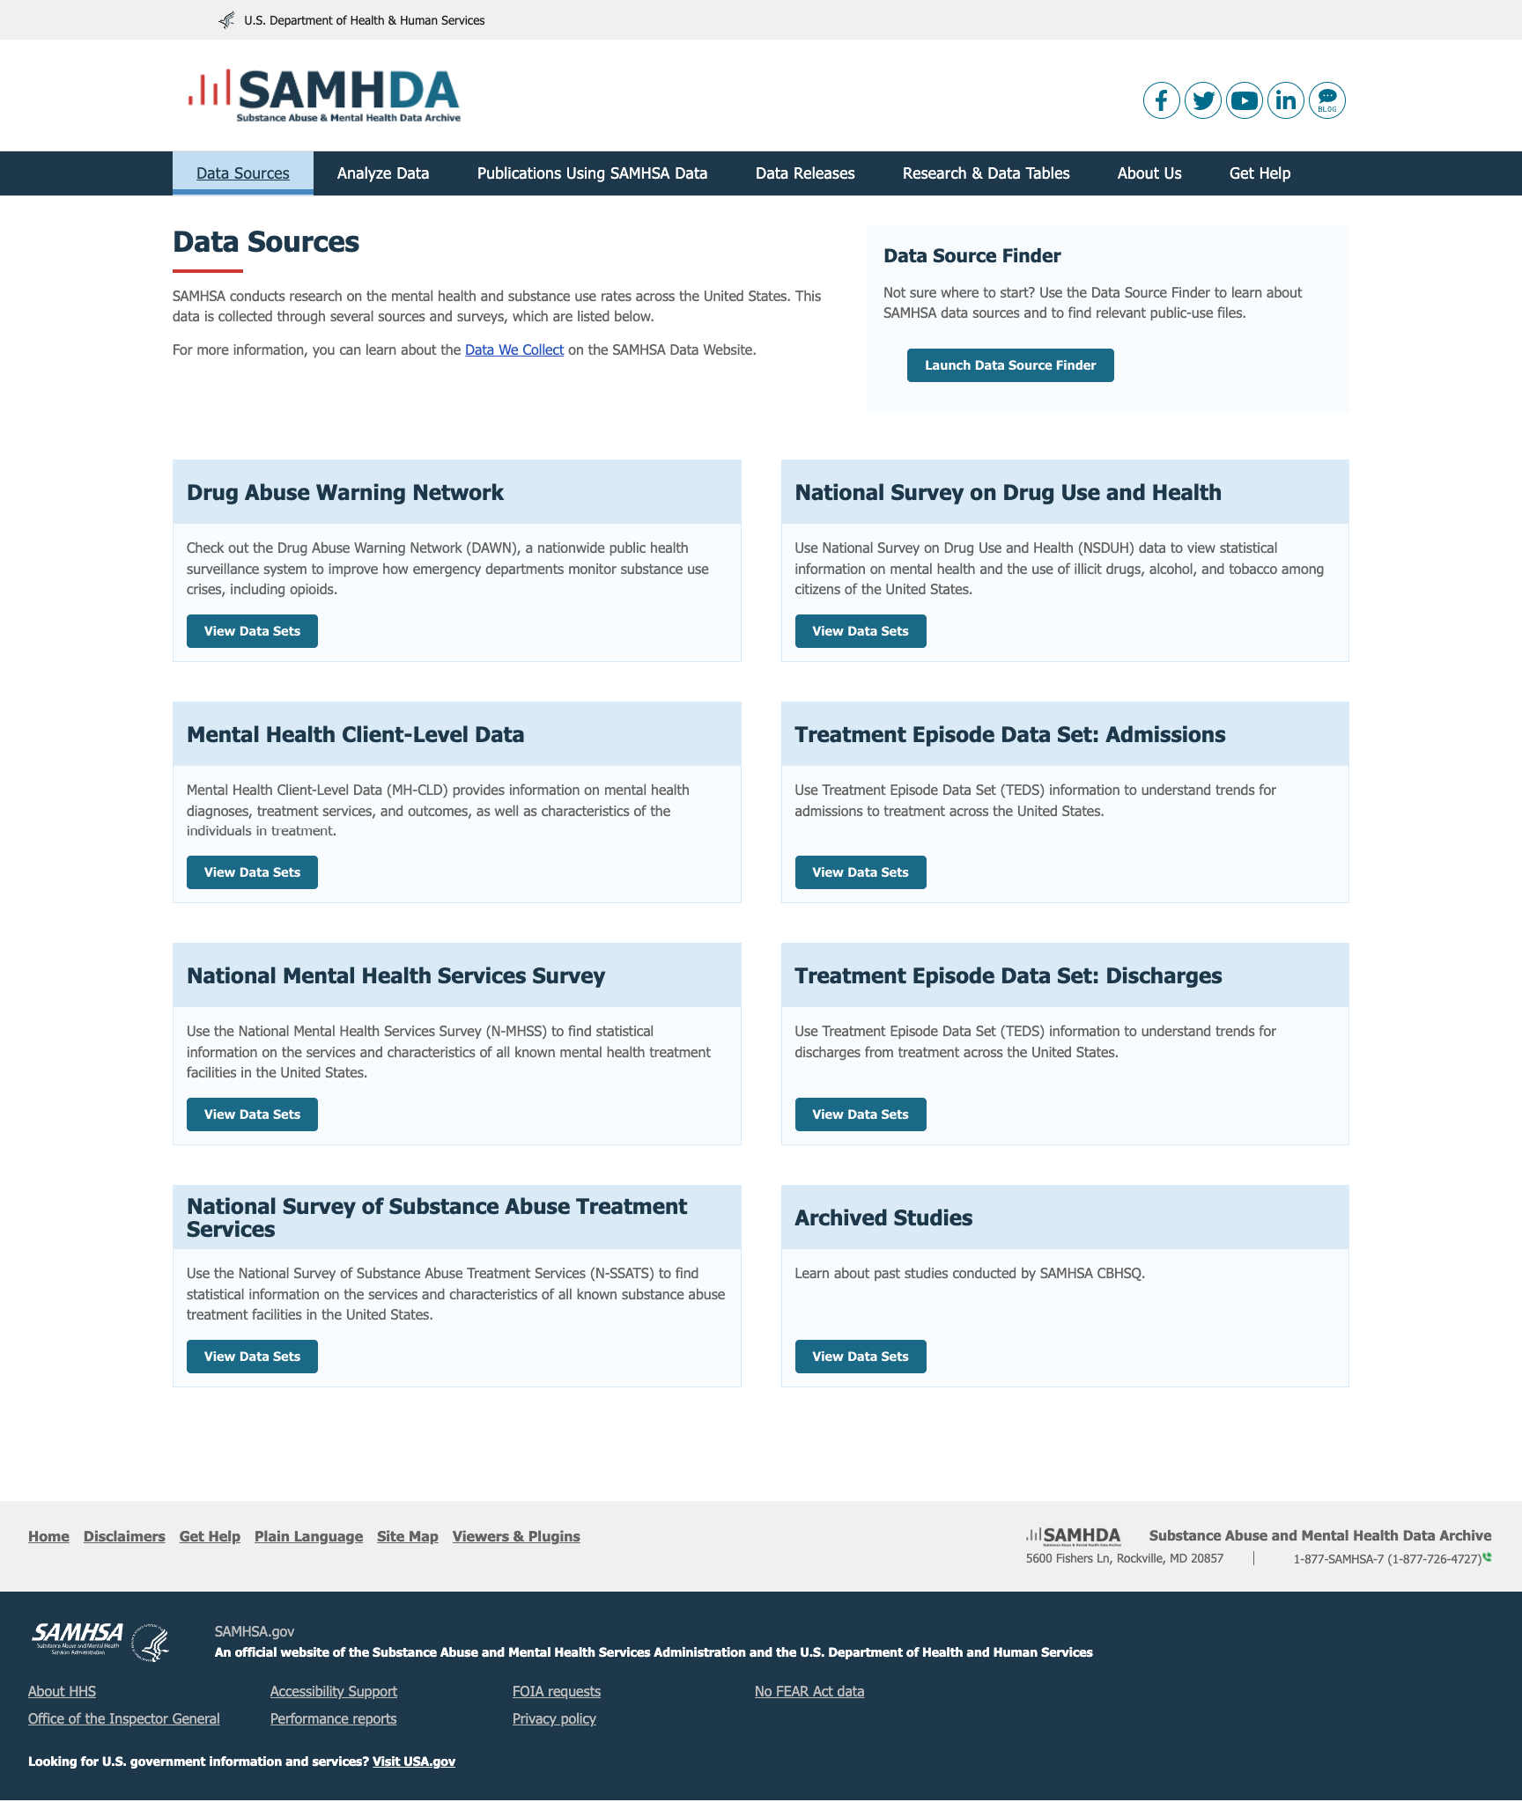
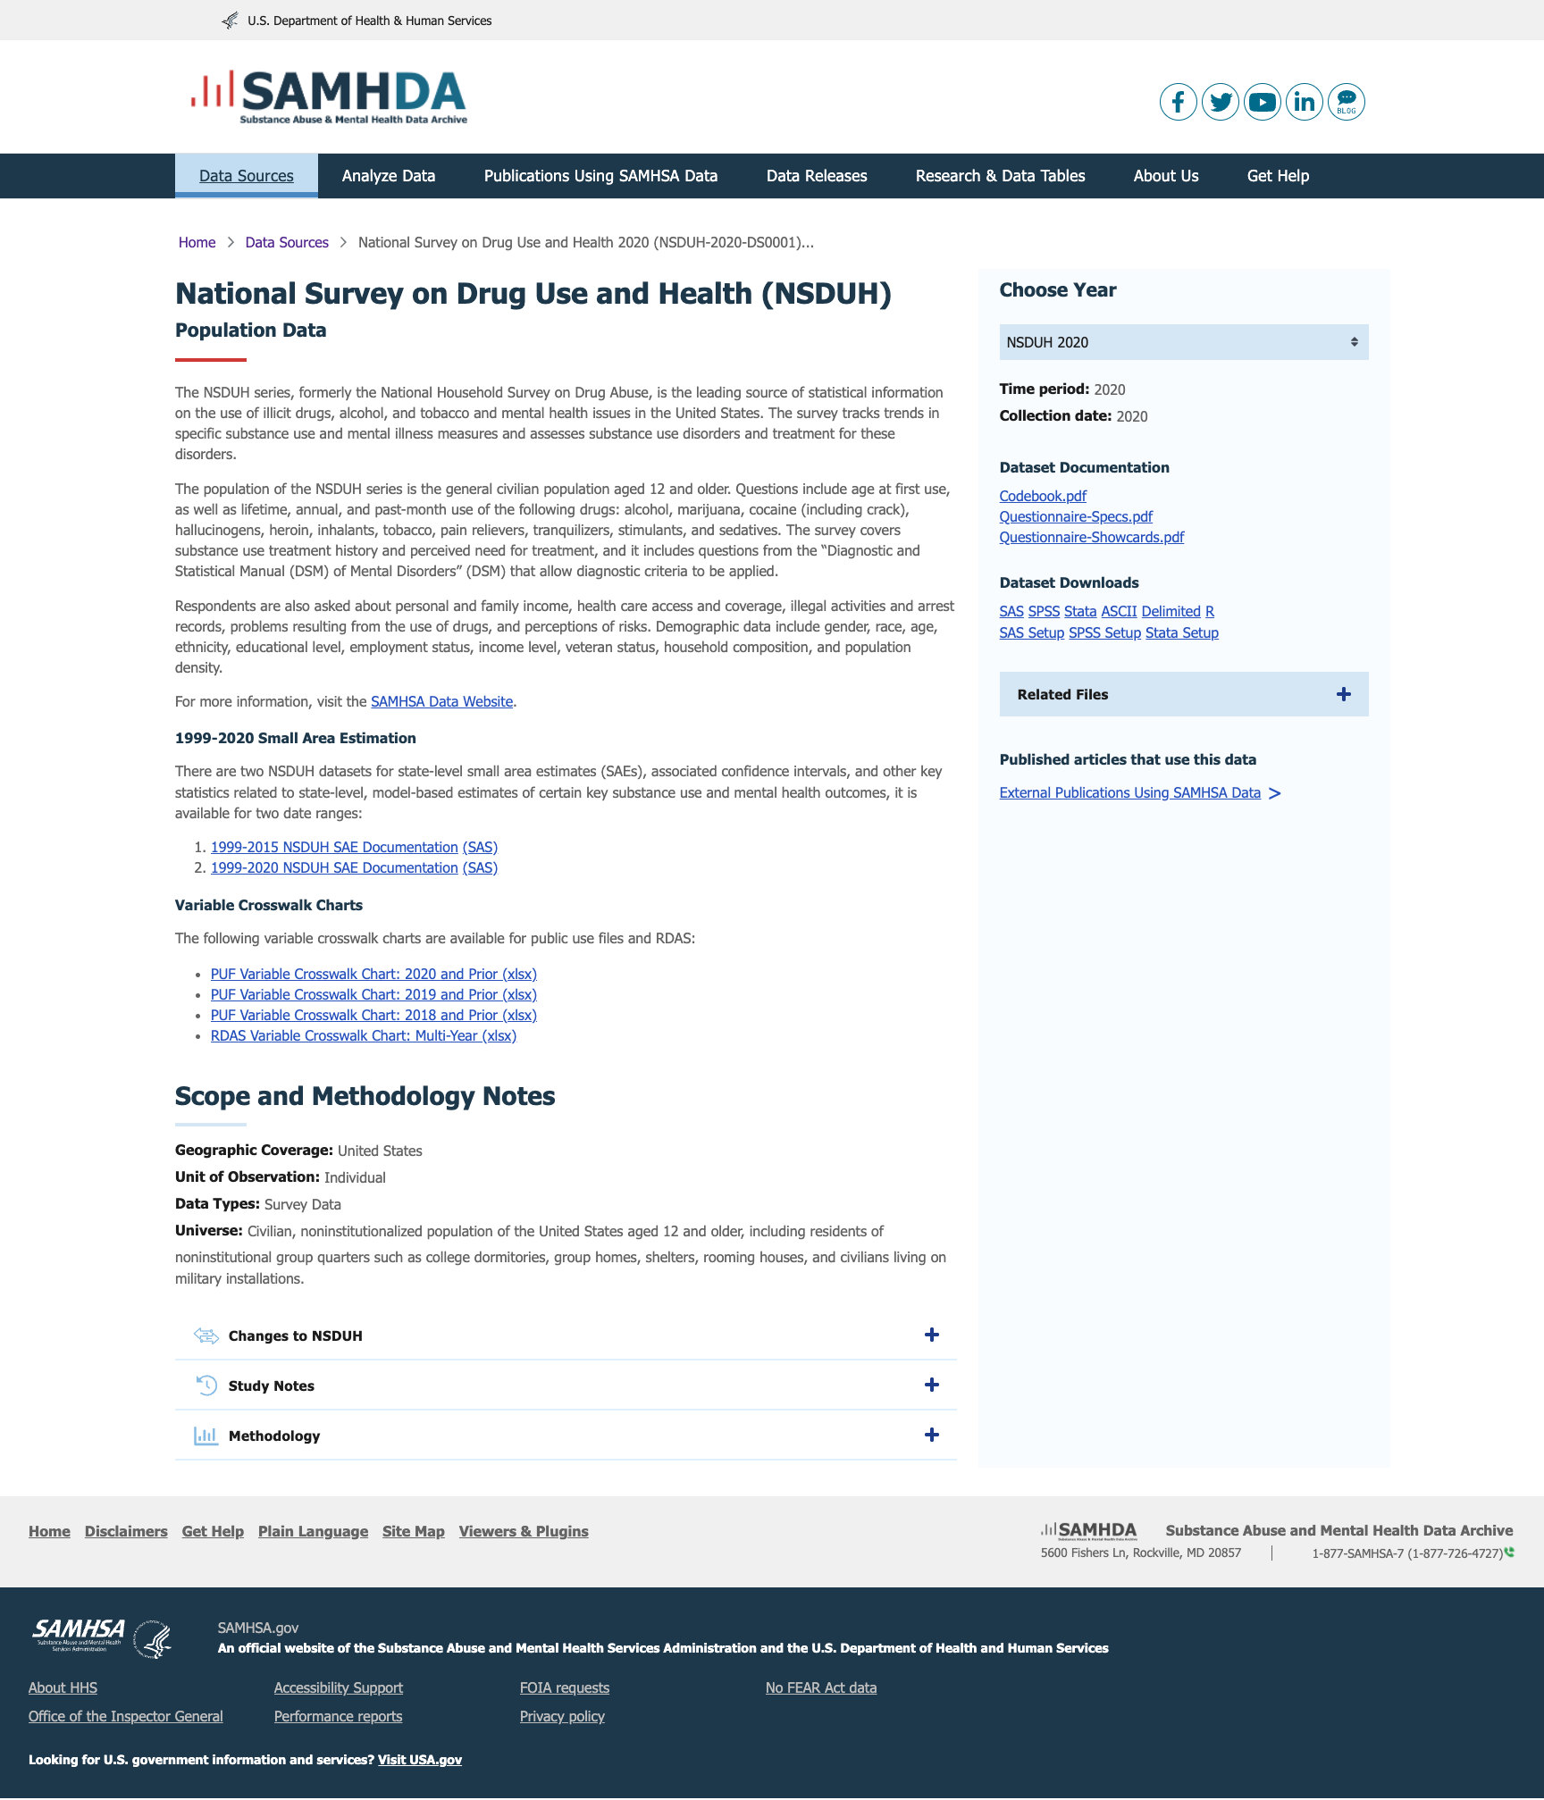
The New Pathway Is Streamlined.
2 click process
Plus, faster multiple pathways from the Data Page
Integrate API

Slide 8
We Reduced Cognitive Load and Became USWDS Compliant.

Slide 9
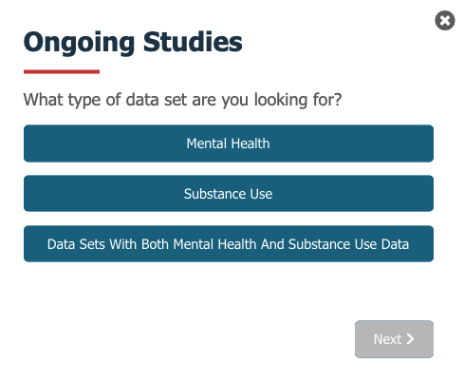
We Added a Wizard to Help New People Find What They Needed.

Slide 10
Our Data Led to Listening Sessions Which Lead to a Product Strategy.
All the things we need to know, we already had!
Compiling data
finding gaps
solutions for improved user experience

Slide 11
Thank you.
SAMHSA’s mission is to reduce the impact of substance abuse and mental illness on America’s communities.
Kathryn Downey Piscopo: Kathryn.Piscopo@samhsa.hhs.gov
www.samhsa.gov
1-877-SAMHSA-7 (1-877-726-4727) ● 1-800-487-4889 (TDD)

